Slide 1
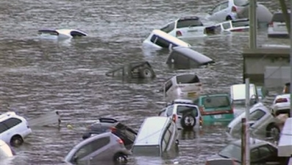
japan: 3/11 earthquake and tsunami
BY: SABRINA MICHEL

Slide 2
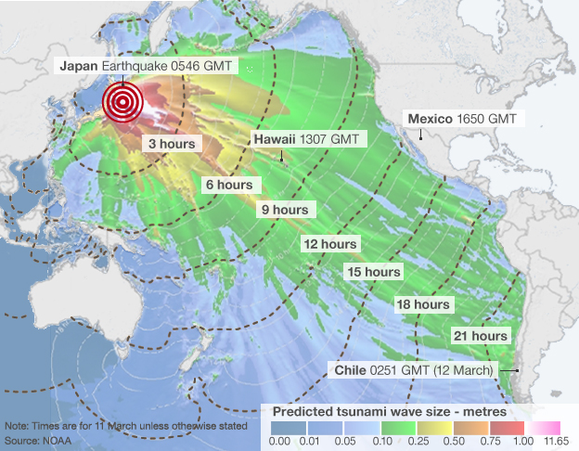
Magnitude of earthquake
On March 11th, 2011 a 9.0 magnitude earthquake hit Japan, lasting approximately six minutes.
It was the most powerful earthquake to ever have hit Japan and the fifth most powerful earthquake in the world since record keeping began in 1900.
The earthquake triggered powerful tsunami waves, some of which reached 133 feet.

Slide 3
Damage of the earthquake
The National Police Agency has confirmed 15, 883 deaths, 6,143 injured, and 2,681 people missing.
The tsunami did most of the damage to the country, however the degree of the earthquake was pretty explosive as well.
Japan’s nuclear power plants were also affected and it currently leaves Japan in a devastating aftermath.
The nation is currently trying to prevent a nuclear meltdown as the Fukushima Nuclear Power Plant had a very destructive affect on the land

Slide 4
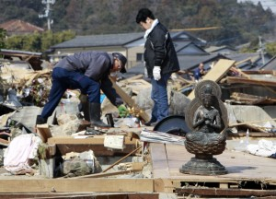
The aftermath…
Today in Japan, there is a spirit of cooperation of the nation. Many people gather together to help rebuild the nation and help one another to get Japan back up on its feet.

